Slide 1
Chapter 2
Jump-Starting RMAN

Slide 2
Background
This chapter was the editor’s idea
The thought was to start out with as simple of a set of examples as possible
This chapter started out from the lab material from one of the authors Oracle B&R classes

Slide 3
Objectives
Connecting to database
Starting/Stopping database
Change archivelog mode
Backup a database using RMAN
Recover a database using RMAN

Slide 4
Connecting To Your Database
Need to define environment variables
  ORACLE_SID
  ORACLE_HOME
  PATH
  How to set these is OS specific
  Using ‘oraenv’ & ‘coraenv’ to set environment (Unix)
  Using Registry to set environment (Windows)

Slide 5
Connecting To Database (cont.)
Need access to a privileged database account
  SYSDBA
  SYSOPER
Using OS Authentication to connect
  Means OS access automatically allows database access
  Can assign groups at install time
  Sqlplus / as sysdba
  Validate using ‘show user’

Slide 6
Connecting To Database (cont.)
Using Password File to connect
  Allows SYSDBA from non-sys user
  Allows connection via Oracle Net
  Created using ‘orapwd’ executable
  Used with remote_login_passwordfile parameter
    EXCLUSIVE
    SHARED
    NONE
  Then ‘grant sysdba to user;’
  View V$PWFILE_USERS to view users granted SYSDBA & SYSOPER
Grant access to SYSDBA with caution

Slide 7
Starting Your Database
Connect as privileged account
Issue ‘startup’ command
Initialization Parameter file must reside in (to use simple ‘startup’):
  ORACLE_HOME/dbs (Unix)
  ORACLE_HOME\database (Windows)
Otherwise, must specify location of file:
  Startup pfile=C:\temp\initORCL.ora

Slide 8
Stopping Your Database
When stopping database, several modes are available:
  NORMAL (default)
  TRANSACTIONAL
  IMMEDIATE
  ABORT (should be used rarely)

Slide 9
Setting Archiving Mode
Connect as SYSDBA
Shutdown your database
Startup in mount mode
Alter the database into archivelog mode
Open your database for use

Slide 10
Setting Archiving Mode (commands)
Connect sys/chaya as sysdba
Shutdown immediate;
Startup mount;
Alter database archivelog;
Alter database open;

Slide 11
Disabling Archiving Mode (commands)
Connect sys/chaya as sysdba
Shutdown immediate;
Startup mount;
Alter database noarchivelog;
Alter database open;

Slide 12

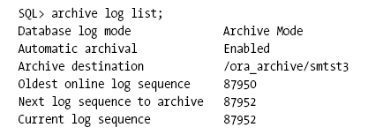
Displaying Archive Information

Slide 13
Archiving and Backups
Archivelog required for online backups
Allows recovery to transaction-level
Management of space is critical
Automatic archiving enabled by default starting with Oracle 10g
  Log_archive_start parameter deprecated

Slide 14
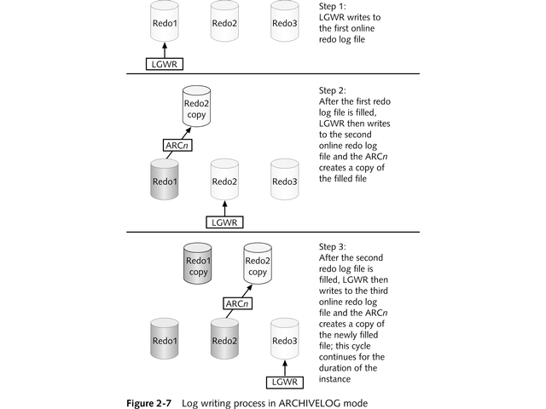
Archiving and Backups
Notes:
Can create manually with Visio so as not to use Thomson graphic..

Slide 15
Connecting to RMAN
Steps needed to connect to RMAN
  Set OS environmental variables
  Access to privileged account (SYSDBA)
  Can connect via command-line
  Can connect via Enterprise Manager

Slide 16
Connecting to RMAN
Connect via the following methods
  rman target /
  rman target sys/<password>
  rman target sys/<password>@dbconstr
  rman
  RMAN> connect target /

Slide 17
Starting/Stopping Your Database with RMAN
  RMAN> startup
  RMAN> shutdown immediate
  RMAN> exit

Slide 18
Backing Up Your Database
Designed for simplicity
Sensible default configuration settings
  Allocates channel for backups
  Specifies default disk location
Little configuration needed for basics
Simple to see status of backups
  ‘list backup’ command

Slide 19

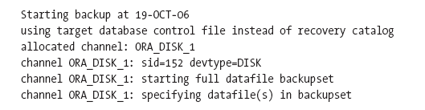
Backing Up Your Database

Slide 20

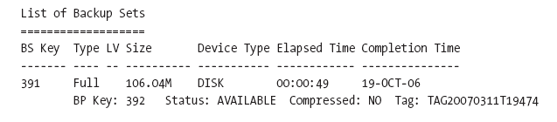
Backing Up Your Database

Slide 21
Restoring & Recovering Your Database
Connect to the target database
Mount the database
Restore the database (files from backup)
Recover the database (applies archive log files)
Open the database

Slide 22

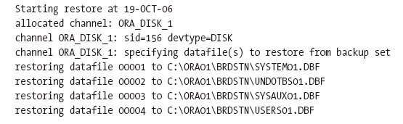
Restore Step

Slide 23

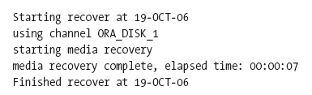

Recover Step

Slide 24
Jump-Starting: Just The Beginning
Again, installed with practical defaults
Ease of use out-of-the-box
Capable to handle industrial-strength environments

